Slide 1
Underlying Technologies
  Training Division

Slide 2
Objectives
Review Data Communications
Be able to define and give examples of LANs
Be able to define and give examples of Point-to-Point WANs
Be able to define and give examples of Switched WANs
Know the various connecting devices and be able to identify which layers they operate in and what operations they perform

Slide 3
Review
TCP/IP is only concerned with the network, transport, and application layers. This means that TCP/IP assumes the existence of WANs, LANS, and the connecting devices that join them.
Data Communications
Telecommunications
LANs
WANs
Connecting Devices

Slide 4
Local Area Networks (LAN)‏
A LAN is a data communications system that allows a number of independent devices to communicate directly with each other in a limited geographical area.
Ethernet
Token Ring

Slide 5
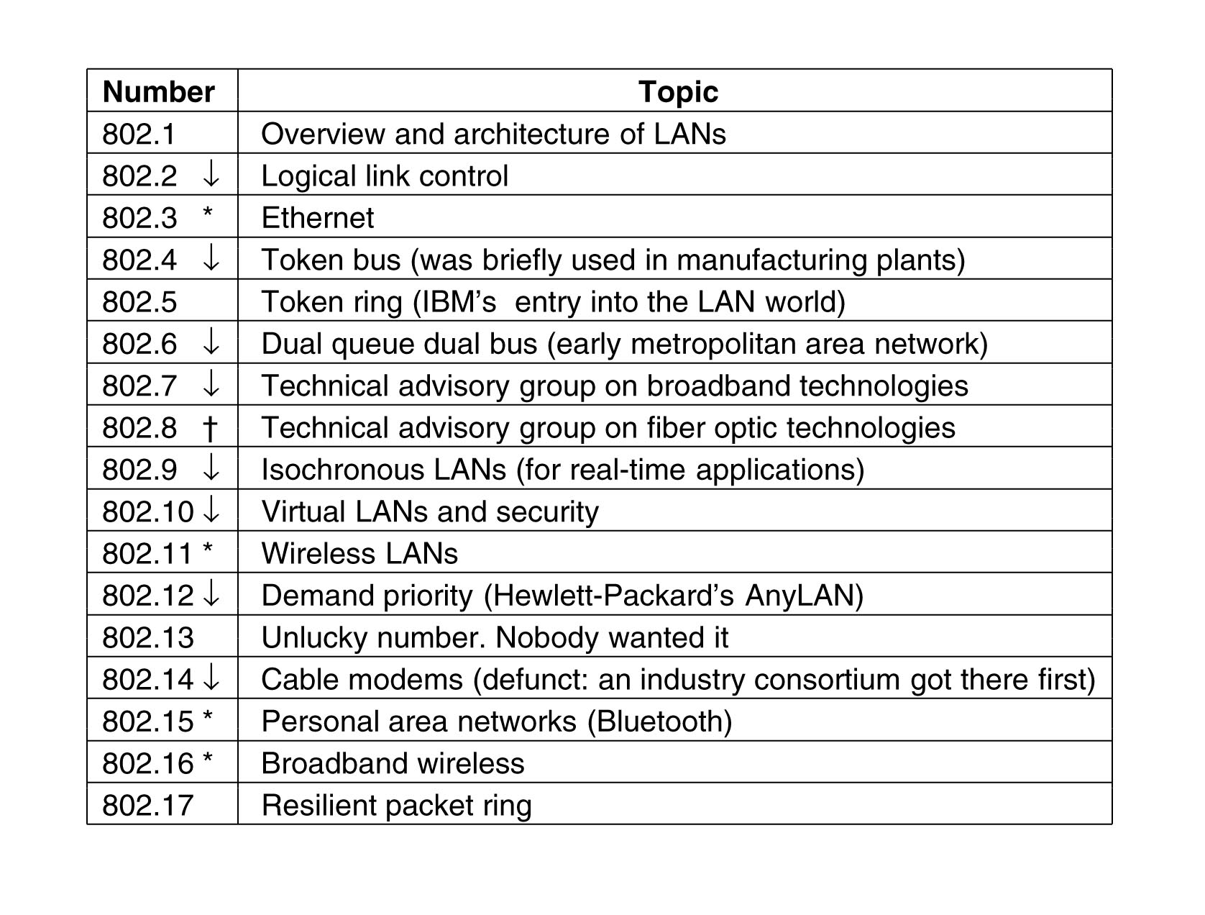
Technologies

Slide 6
Ethernet
Most widely used local area network protocol (IEEE 802.3). Designed in 1973 by Xerox.
Traditional Ethernet 10 Mbps
Fast Ethernet 100Mbps
Gigabit Ethernet 1000Mbps

Slide 7
Traditional Ethernet 10 Mbps
Stations connected using a physical bus or star topology
Logical topology always a bus
Only one station can transmit at a time
All stations receive the data, all except the actual destination drop the frame.

Slide 8
Access Method: CSMA/CD
Each station has equal right to the medium (multiple access)‏
Each station listens to (senses) the medium before sending (carrier sense)‏
If idle then start sending.
If a collision occurs whilst sending (collision detection), a jam signal is sent to destroy the data and then each station waits a random time before resending.
Collision domain almost 2500 meters

Slide 9
Layers
Data Link Layer has two sublayers
  Logical Link Control (LLC) responsible for flow and error control.
  Media Access Control (MAC) responsible for the operation of the CSMA/CD access method.
Physical Layer transfers data into electrical signals and sends them to the next station.

Slide 10
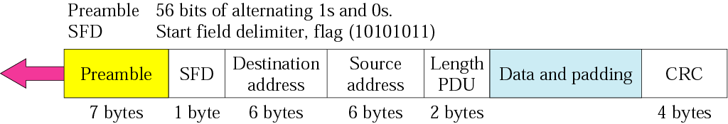
Frame
IEEE 802.3 specifies one frame type containing seven fields.
No mechanism is provided for acknowledging received frames, so it is an unreliable medium.

Slide 11
Fields
Preamble - alerts receiving system to the incoming frame and allows for synchronisation (7 bytes)‏
Start frame delimiter (SFD) - signals the beginning of the frame
Destination address (DA) - physical address of the destination
Source address (SA) - physical address of the sender
Length/type - length of data field that follows or defines upper layer protocol (PDU – Protocol Data Unit)‏
Data - data encapsulated from the upper layer protocols (min.46 – max.1500 bytes)‏
CRC - error detection information

Slide 12
Addressing
Network Interface Card (NIC)‏
  6-byte physical address
Ethernet Addresses
  Unicasting : least significant bit of the first byte is 0
  Multicasting : least significant bit of the first byte is 1
  Broadcasting : all 48 bits are 1s
  Source address is always unicast

Slide 13
Implementations
10BASE5 (thick Ethernet)‏
  bus topology with thick coaxial cable
10BASE2 (thin Ethernet or Cheapernet)‏
  bus topology with thin coaxial cable
10BASE-T (twisted-pair Ethernet)‏
  physical star topology (logical still bus) with two pairs of twisted-pair cable to a hub
10BASE-FL (fibre link Ethernet)‏
  star topology (logical still bus) with pairs of fibre-optic cable to a hub

Slide 14
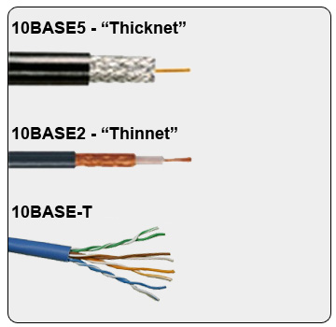
Implementations

Slide 15
Fast Ethernet
Same as traditional Ethernet except transmission rate is 100 Mbps
Collision domain 250 meters
Implementation
  100BASE-X => two-wire
  100BASE-TX => twisted-pair cable
  100BASE-FX => fibre-optic cable
  100BASE-T4 => four wire twisted-pair cable

Slide 16
Gigabit Ethernet
At the physical level, many changes have been made to allow this data rate
Implementation
  1000BASE-X => two-wire
  1000BASE-SX => optical fibres transmitting short-wave laser signals
  1000BASE-LX => optical fibres transmitting long-wave laser signals
  1000BASE-CX => shielded twisted pair transmitting electrical signals
  1000BASE-T => four-wire version using twisted-pair cables

Slide 17
Token Ring
Token passing access method (802.5)‏
When n/w is idle a 3-byte token circulates
Station to send data keeps the token and sends the data
Data reaches the destination, changes 4 bits in the last byte of the frame to indicate address recognized and frame copied
The full pack goes round until reaches the source

Slide 18
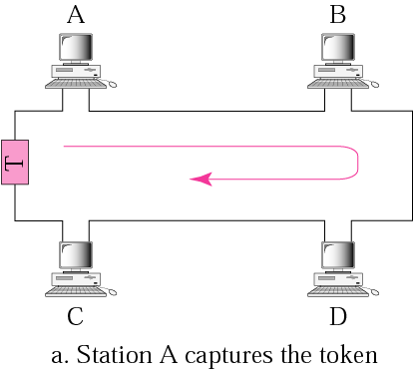
Token passing (a)‏

Slide 19
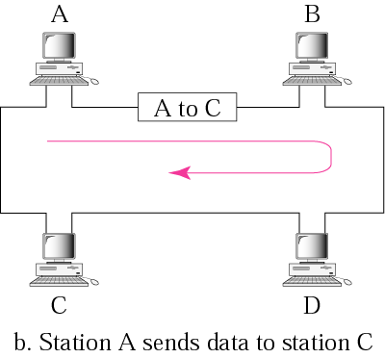
Token passing (b)‏

Slide 20
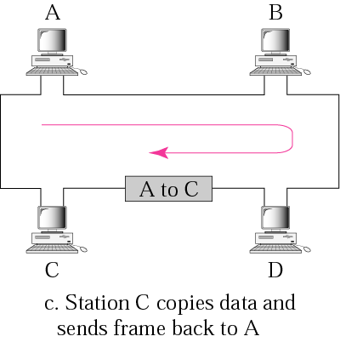
Token passing (c)‏

Slide 21
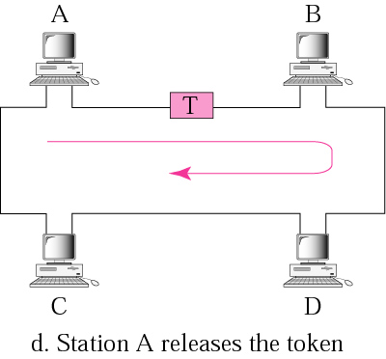
Token passing (d)‏

Slide 22
Frames
Data Frame
Token Frame
Abort Frame

Slide 23
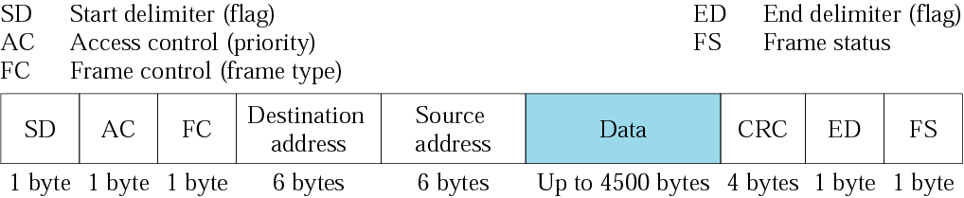
Data Frame
Carries the protocol data unit and addressed to a specific destination

Slide 24
Fields
Start delimiter (SD) - alerts the receiving station to arrival of frame and synchronisation
Access control (AC)‏
  Priority field
  Token bit; set to indicate frame is a token frame
  Monitor bit
  Reservation field; set by stations wishing to reserve access to the ring
Frame control (FC) - indicates type of information; control information or data
Destination address (DA) - physical address of next destination

Slide 25
Fields (cont.)‏
Source address (SA) - physical address of sender
Data - 4500 bytes containing the protocol data unit (PDU)‏
CRC - error detection sequence
End delimiter (ED) - indicates end of sender's data and control information
Frame status (FS) - set by receiver to indicate frame has been read, or by monitor to indicate that the frame has already been around the ring

Slide 26
Token Frame
Just a placeholder and reservation frame.
Starting delimiter (SD)‏
  frame is coming
Access control (AC)‏
  frame is a token and includes the priority and reservation fields
End delimiter (ED)‏
  end of frame

Slide 27
Abort Frame
Contains no information just starting and ending delimiters, generated by sender to stop its own transmission, or by monitor to purge old transmission.

Slide 28
Implementation
Series of shielded twisted-pair sections linking each station to its immediate neighbours
Each station is connected to a switch which can bypass an inactive station

Slide 29
Wireless LANs
One of the fastest growing technologies
IEEE defines 802.11 as standard specification
It covers the physical and data link layer
It is used to connect to internet
It has two kind of services BSS(Basic Service Set) & ESS(Extended Service Set)‏

Slide 30
Technologies
IEEE 802.11
BSS consists of stationary and mobile stations .
  BSS without a stationary station (AP) Access Point is unable to communicate to the outside network which is also known as ad hoc architecture.
  ESS is made up of two or more BSS with AP's
    Uses distribution system, usually wired LAN for connecting the AP's Together.
    Mobile Stations can belong to more than one BSS
Access Methods
  CSMA/CA Carrier Sense Multiple Access with Collision Avoidance
  Avoidance because stations may not be able to hear each other (obstructed; mountain or wall).
  Stations define how long they need the medium and tell other stations to refrain from sending data during this period.

Slide 31
Point-to-Point WANs
Connects two remote devices using a line available from a public network such as a telephone network (normally at the physical layer).

Slide 32
Physical Layer
Connection by one of several services available.
  Uses Modem, DSL Line, Cable Modem, T-line or SONET for connecting the device to the network.

Slide 33
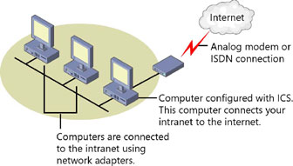
Modem
Used to connect to the Internet with speed of 56Kbps.
Upload speed (33.6Kbps) is lesser than the download speed.
Telephone companies sample voice 8000 times per second with 8 bits per sample, and one bit in each sample is for control information so the speed is 7 * 8000 = 56000 Bps or 56Kbps.

Slide 34
Digital Subscriber Line (DSL)‏
Asymmetric Digital Subscriber Line (ADSL)‏
Asymmetrical => higher bit rate in the downstream direction similar to a modem.
Unlike the modem the channels for communication are fixed.
Voice : Channel 0 is reserved for voice communication.
Idel: Channel 1 – 5 are not used to provide gap between voice and data communication.
Upstream Data: Channel 6 – 30 (25) used only for upstream communication, One is reserved for Control and 24 for data. Give speed of 1.44 Mbps
Downstream Data: Channel 31 – 255 (225) used only for downstream communication, one is reserved for Control and 224 for data. Give speed of 13.4 Mbps
But due to High Signal/Noise Ratio, the actual speed is much less.

Slide 35
Data Link Layer
Point-to-Point Protocol (PPP)‏
  Controls and manages the transfer of data
  Provides a reliable point-to-point connection over the physical link
  Does not define any protocol for Physical layer it is left for the implementer
  Define LCP(Link Control Protocol), NCP(Network Control Protocol)

Slide 36
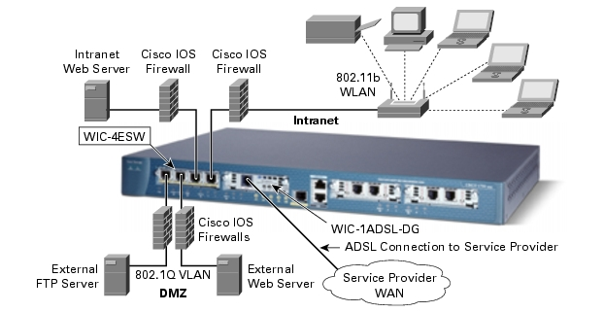
Switched LANs

Slide 37
Switched WANs
Usually used for backbone networks in the Internet.
Covers a large area (state or country) and provides access at several points to the user.
A mesh of point-to-point networks within.
Connection-oriented technology

Slide 38
X.25
Almost obsolete
The first switched WAN to become popular
Designed for unreliable media
Large overhead due to flow and error control at both data link and network layers

Slide 39
Frame Relay
Designed to replace X.25
Higher Data Rate
Accepts Bursty Data - users are granted an average data rate that can be exceeded when required.
Less overhead. All error checking is left to the protocols at the Network and Transport Layers

Slide 40
Connecting Devices
Repeater --- PHYSICAL
Hubs
Bridges --- DATA LINK
Switches
Router --- NETWORK
Gateway --- APPLICATION

Slide 41
Repeater
Operates in the physical layer
No physical address.
Regenerates the original bit pattern
Extends the physical length of a network
Forwards every packet; has no filtering capability.

Slide 42
Hubs
A multi port repeater
Used to create connections between stations in a physical star topology
Still a logical bus topology

Slide 43
Bridges
Operates in both the physical and data link layers
No physical address.
Physical Layer => regenerates the signal it receives
Data Link Layer => checks the physical address in a packet and decides if it should be forwarded or dropped (filtered)‏
Connects segments of a LAN together.

Slide 44
Switches
Two-Layer Switch
  A bridge with many interfaces
  A bridge with an interface for each station means no competing traffic.
Three-Layer Switch
  Router with improved design to allow better performance
  Can receive, process, and dispatch a packet much faster than a traditional route

Slide 45
Router
Operates in the physical, data link, and network layers.
Physical Layer => regenerates the signal it receives
Data Link Layer => Checks the physical address in the packet
Network Layer => checks the network layer address (IP)‏

Slide 46
Router
Can connect LAN - LAN, WAN - WAN and LAN - WAN
Two networks (LANs or WANs) connected by a router become an internetwork or an internet.
Route packets among multiple interconnected networks

Slide 47
Router
Different to a Repeater or Bridge
  Has a physical and logical (IP) address for each of its interfaces
  Acts only on packets that have the destination address matching the address of the interface it arrives on
  Changes physical address (source and destination) when it forwards the packet

Slide 48
Gateway
Gateways work on all seven OSI layers .
The main job of a gateway is to convert protocols among communications networks.
A router by itself transfers, accepts and relays packets only across networks using similar protocols. A gateway on the other hand can accept a packet formatted for one protocol (e.g. AppleTalk) and convert it to a packet formatted for another protocol (e.g. TCP/IP) before forwarding it.
A gateway can be implemented in hardware, software or both, but they are usually implemented by software installed within a router.
A gateway must understand the protocols used by each network linked into the router. Gateways are slower than bridges, switches and (non-gateway) routers.

Slide 49
Connecting Devices
Gateway
Router
Bridge
Repeater‏

